Slide 1


MBK Houston Initiative
Social Justice Learning Institute
Urban Scholars
Government Operations Committee
Presented by:
Director Stephen L. Williams, M.Ed., MPA
Assistant Director Patricia Watson, MBA
Tuesday, April 16, 2024

Slide 2

ABOUT MBK

Slide 3
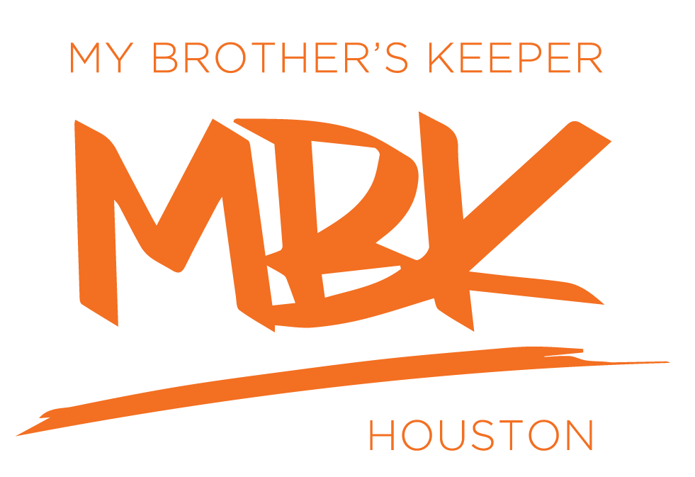
THE MBK COMMUNITY CHALLENGE
President Obama launched My Brother’s Keeper (MBK) in February 2014 and challenge cities to join the effort to address the persistent opportunity gaps boys and young men of color face and to ensure all young people can reach their full potential.
Mayor Annise Parker accepted the challenge and appointed Director Stephen Williams to lead Houston’s effort.
MBK is rooted in six milestones that research shows are predictive of later success, & where interventions can have the greatest impact.
Notes:
Vision: To see boys and young men of color reach their full potential by providing opportunities for growth, access to resources, removing barriers to success, and creating clear pathways to advancement.

Slide 4
THE NEED FOR ACTION
A required data report documented the need for Houston to join the MBK Community Challenge. At the time of the challenge:
Over 50% of Houston’s youth ages 10-24 years were Hispanic and 25% were Black
Out of school suspension for serious offenses was 2x higher among Black male youth compared to White male youth
Approximately 40% of Latinos and Blacks lived in poverty
More recent data illustrate continuing disparities in conditions and outcomes

Slide 5

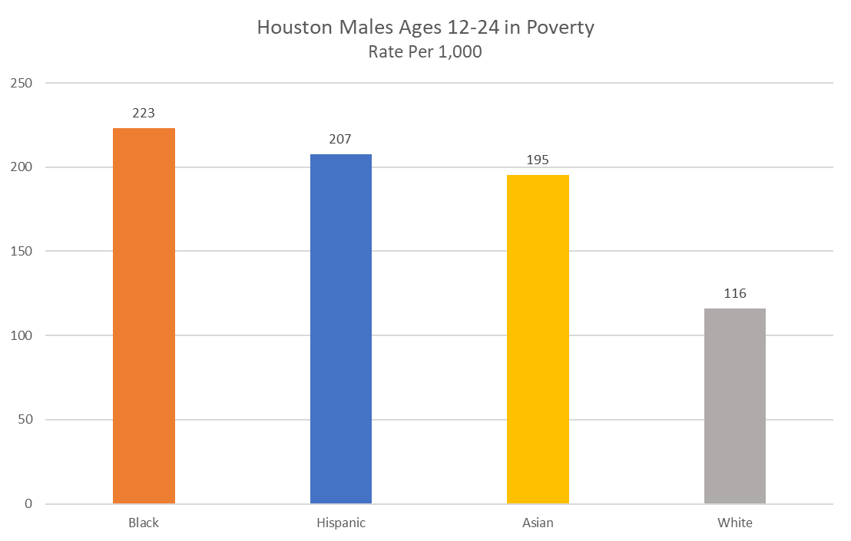


City of Houston Youth: Poverty
Black youth are 1.9 times more likely to be in poverty than white youth.
American Community Survey B17001 – Poverty Status In The Past 12 Months– Houston City
2021 5-year Estimate*

Slide 6
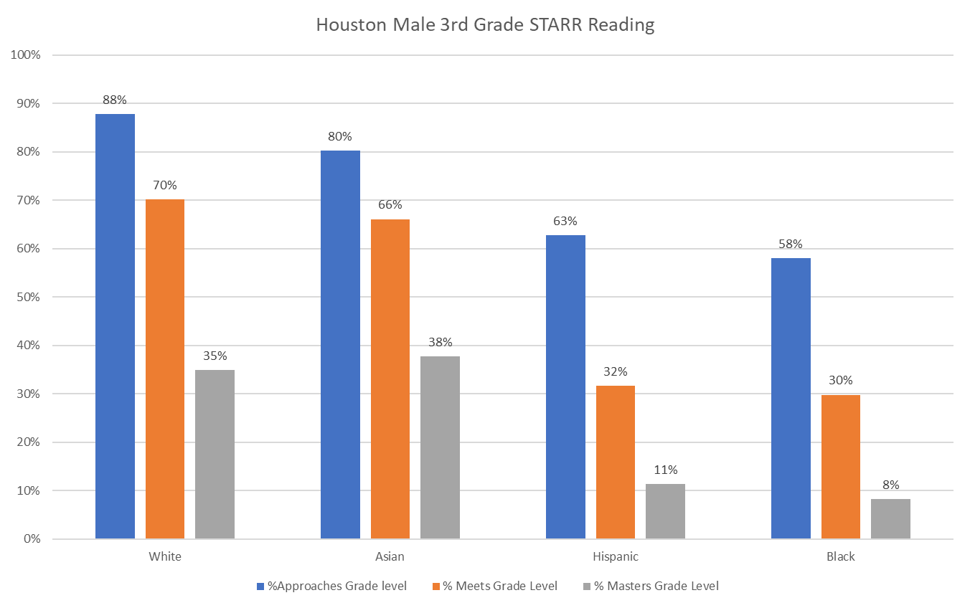
City of Houston Youth: Reading
Children who do not read proficiently by the end of third grade are 4 times more likely to not graduate high school on time.
HISD – District and School Results from the State of Texas Assessments of Academic Readiness (STAAR) Grades 3-8, Spring 2023

Slide 7
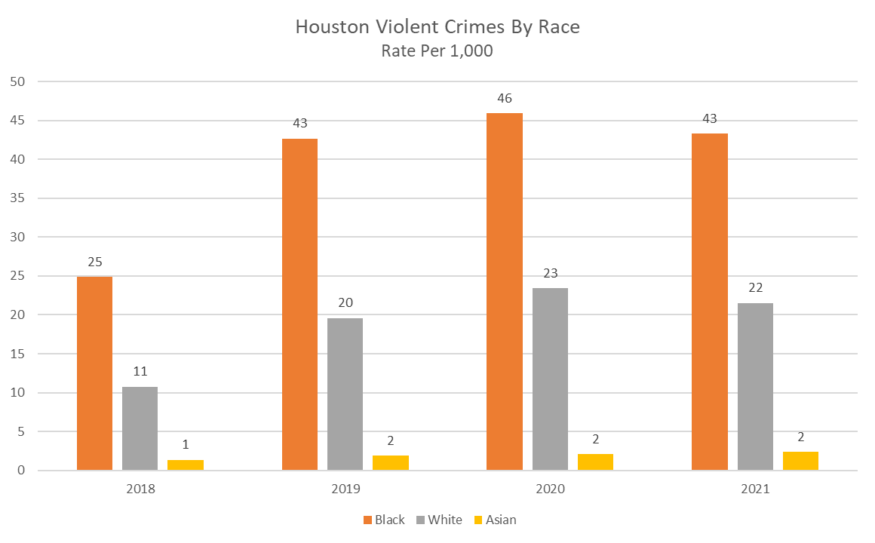
City of Houston Youth: Violent Crimes
Black population are 2 times more likely to be arrested and charged than white youth.
Houston Police Department (HPD) – National Incident-Based Reporting System (NIBRS) - 2021
American Community Survey B01001 – Sex By Age – Houston City
Demographic Population 2018-2021*

Slide 8
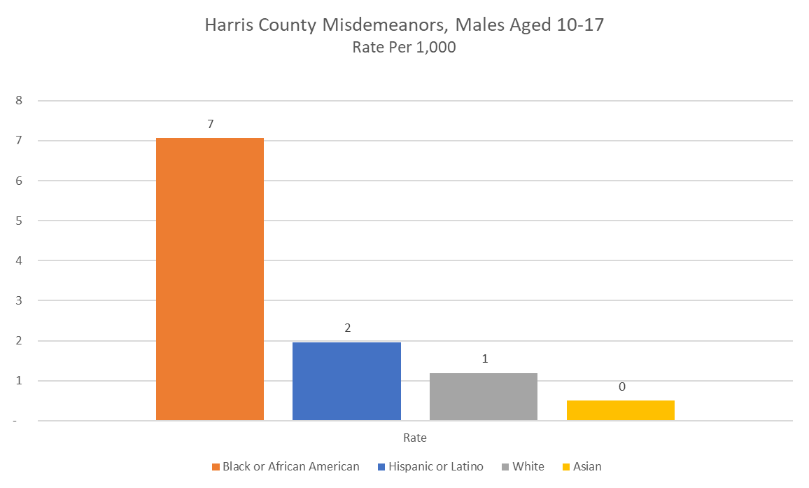
City of Houston Youth: Justice
Black population are 7 times more likely to be in juvenile justice system because of misdemeanor offenses than white youth.
Youth Misdemeanor Arrests (Referrals) – Harris County Juvenile Probation Department - 2022

Slide 9
MBK LOCAL ACTION PLAN
MBK Houston was launched in 2014 and a Local Action Plan was released in 2015 after a communitywide planning process.
The Local Action Plan addressed the 6 MBK Milestones and including six cross cutting strategies:
Develop data and success indicators
Bolster Parent Engagement
Drive community partnerships
Promote in school efforts
Engage progress monitoring systems and
Assess plan effectiveness
An initial strategy for MBK was to prioritize activities in 3 school feeder patterns: Wheatley, Kashmere and Scarborough

Slide 10
MBK MILESTONES
Milestone 1: Entering School Ready To Learn
Milestone 2: Reading at grade Level by 3rd Grade
Milestone 3: Graduating from High School Ready for College and Career
Milestone 4: Complete Post-Secondary Education
Milestone 5: Successfully Entering the Workforce
Milestone 6: Reducing Crime and Violence and Providing a Second Chance

Slide 11
MBK MILESTONES
Consistent with the MBK Local Action plan, HHD supports several initiatives that are designed to provide students, their families and support systems with tools to increase the likely of success across the 6 MBK Milestones
The Social Justice Learning Institute’s Urban Scholars program is one of these initiatives
This initiative supports the MBK cross cutting strategies to bolster in school efforts and drive community partnerships and addresses Milestone 3 which is graduating high school ready for college and career

Slide 12



HHD Programs for Healthy Children
Learning & Skill Building
Social & Emotional Well-Being
Supports
Constructive Use of Time
Summer Employment Opportunities
MBK Wrap Network
Early Warning System
Systems of Care
Behavioral Health Services
Service Coordination
Urban Scholars
CIS XY Zone
See To Succeed
Win Win, Conflict Resolution Training
VIOLENCE PREVENTION PROGRAMS
ReDirect (Diversion)
Community Re-Entry Network
Credible Messengers
Community Violence Interruption
Notes:
Research shows that children need an array of things to grow up healthy, caring and responsible including support, constructive use of time a sense of belonging and connectedness, positive self identity and a commitment to learning. On this slide, we have grouped interventions into four domains that will address these multiple factors.
We are working with an array of partners to produce programs and services that address each of these domains.
We know that even good children, when left alone, can get into trouble. That’s why afterschool programs and constructive use of time is important.
We know that students with a caring adult are more likely to succeed and that’s why we are including individual and group mentoring components..

Slide 13
HHD FUNDING STRATEGY THROUGH COLLABORATION
No budget allocations for MBK Houston and youth programming other than allocations from City Council Members
MBK Houston funded primarily with HHD 1115 waiver funds
HHD strategically partners with organizations with mutual goals and willing to share resources to support MBK Houston efforts
The Social Justice Learning Institute provides a match for the funds that HHD contributes to the program. The initial match to start the program was $200K.
Former Councilmember Karla Cisneros, donated $200K of her district council funds to expand the Urban Scholars program to schools in her district after learning of the program’s success rate with participating students.

Slide 14

Social Justice Learning Institute (SJLI): Urban Scholars
Program Outcomes for 2022-2023:
100% Graduation for all Urban Scholars seniors and successful post-secondary transition.
90% Attendance average for Urban Scholars also throughout 2019-2020 and 2020-2021.
70% average passing rate for core courses across all schools.
All students received wellness calls.
A 105% growth in Urban Scholars participants since 2018-2019.
100% increase in school site service staff.
The SJLI-Urban Scholars program engages youth with the goals of:
Improving the education, health, and well being of youth and communities of color by empowering them to enact social change through research, training, and community mobilization.
Notes:
Partnering Schools (2020-2021 Academic Year)
Attucks Middle School
Clifton Middle School
Sam Houston MSTC High School
Wheatley High School
SJLI has the capacity to expand services to 3 additional schools at the cost of $200,000 per fiscal year if funds were available.
Should funding be available, HHD is prepared to collaborate with SJLI for expansion to 3 additional schools.

Slide 15


URBAN SCHOLARS TIMELINE WITH HHD
Timeline:
2019 - 2020: The Urban Scholars program begins first full academic year.
Attucks Middle School
Clifton Middle School
Sam Houston MSTC High School
Phillis Wheatley High School
2020-2021: First expansion school introduced
Evan Worthing High School
2023-2024: District H expansion schools begin
Marshall Middle School
Booker T. Washington High School

Slide 16
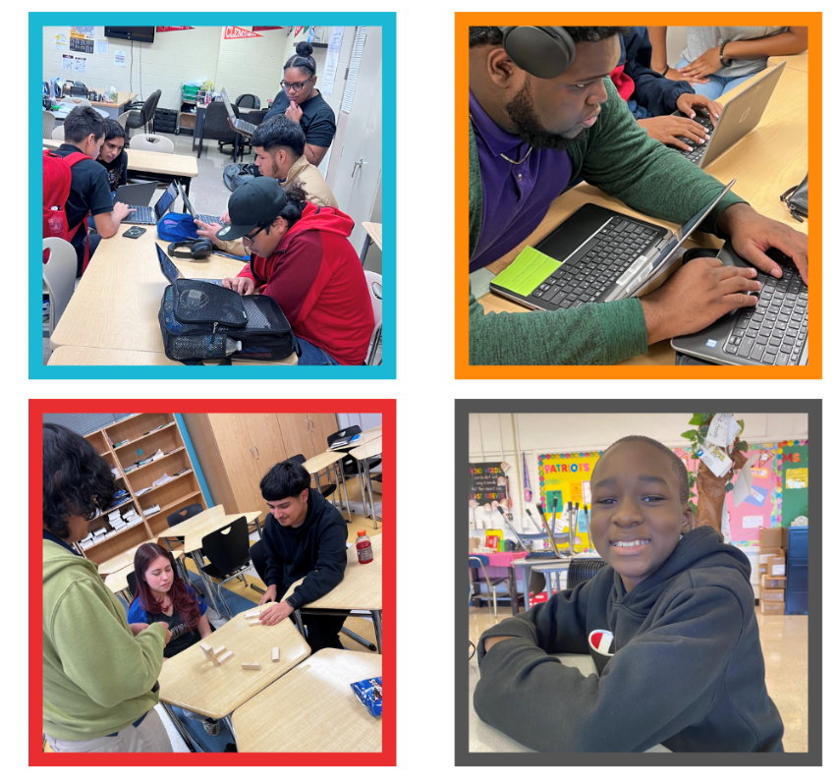
URBAN SCHOLAR SCHOOLS
CURRENT SCHOOLS
Attucks MS
Booker T Washington HS
Clifton MS
Marshall MS
Sam Houston HS
Wheatley HS
Worthing HS

Slide 17
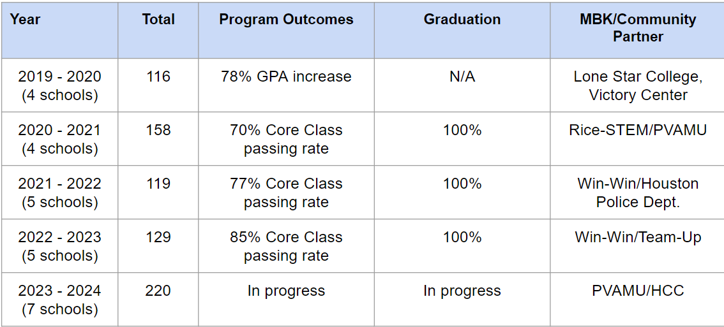
Social Justice Learning Institute Outcomes 2019 - 2024

Slide 18
Amendment Request
The Amendment for additional time and spending authority was submitted to:
Add additional funding, which was provided by the reallocation of Council district dollars of $200,000, to the existing contract
Extend the performance period for the contract to include an additional school year through June 30, 2025
Change the project scope to add the 3 new school locations made possible with the district dollars
Notes:
Vision: To see boys and young men of color reach their full potential by providing opportunities for growth, access to resources, removing barriers to success, and creating clear pathways to advancement.

Slide 19
Additional Funding Request
The following breakdown shows the additional funding that is being added to the existing contract to cover expenses for FY24 and FY25.
FY24 $450,000 ($250,000 from HHD 1115 Waiver Funds – Special Funds)
($200,000 received from Councilmember Cisneros District Dollars – CDSF)
($250,000 In Kind from SJLI)
FY25 $350,000 ($350,000 from HHD 1115 Waiver Funds – Special Funds)
($350,000 in kind from SJLI)
__________________________________________________________
$800,000 TOTAL
Notes:
Vision: To see boys and young men of color reach their full potential by providing opportunities for growth, access to resources, removing barriers to success, and creating clear pathways to advancement.

Slide 20

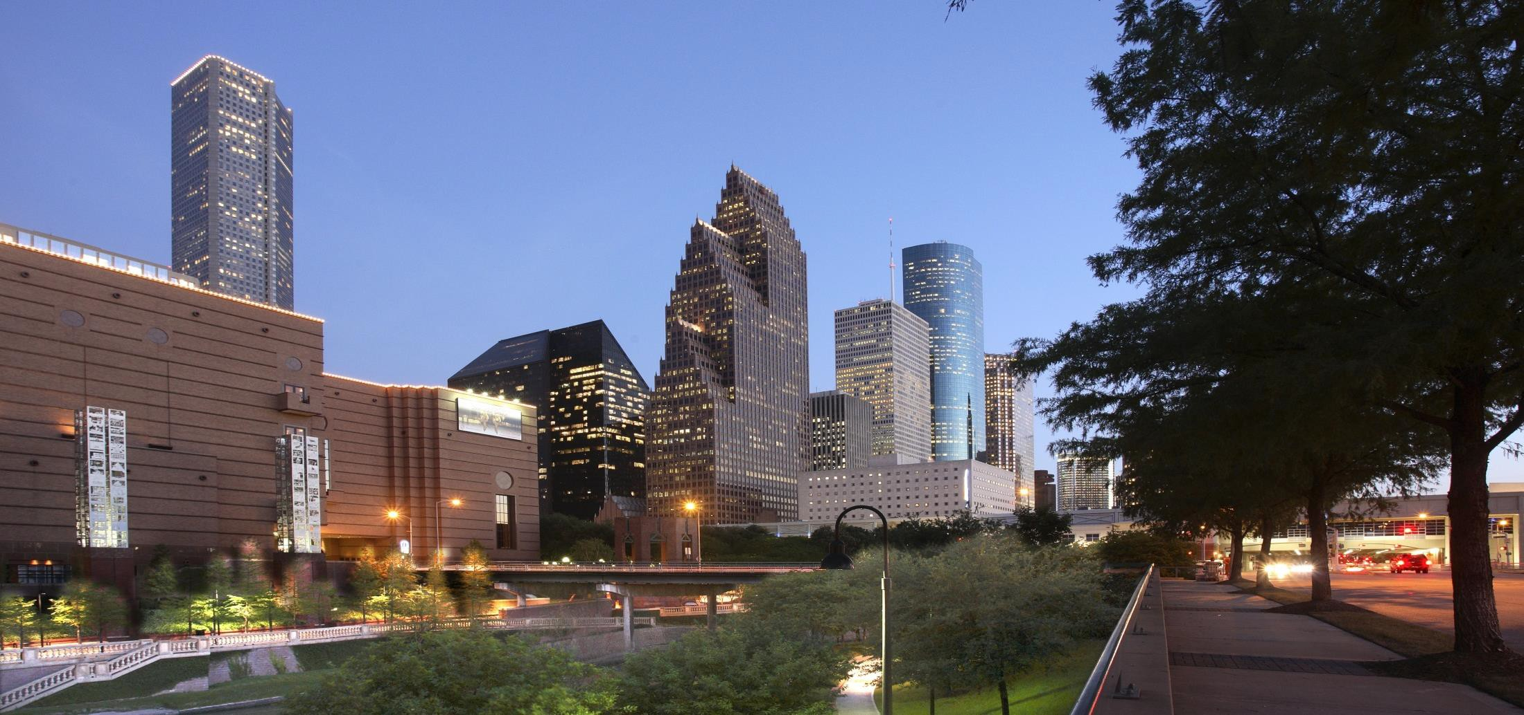



THANK YOU

