Slide 1

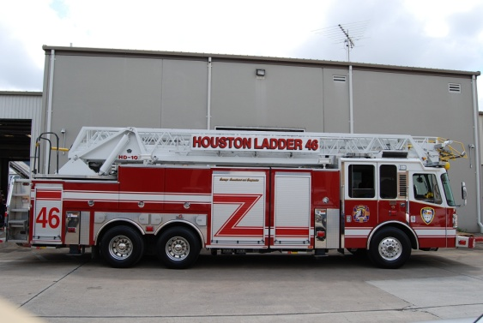
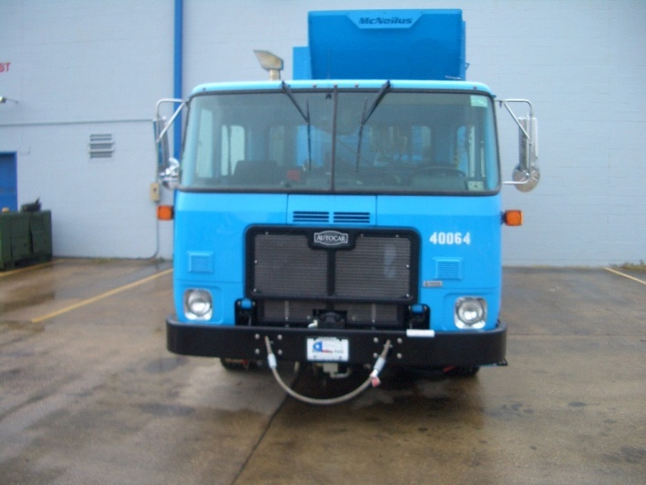
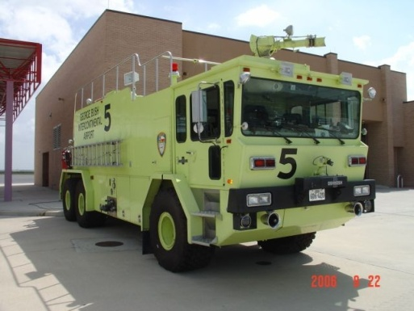
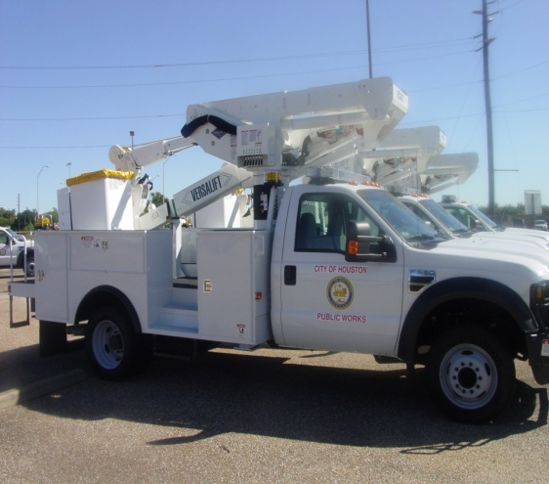
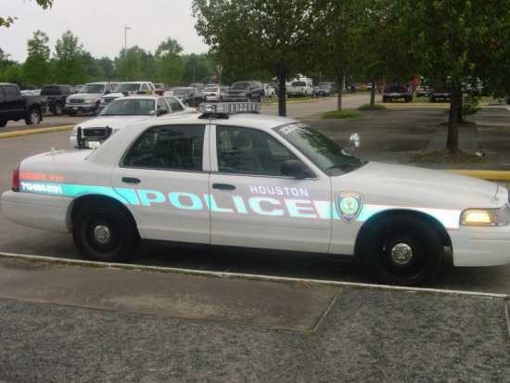
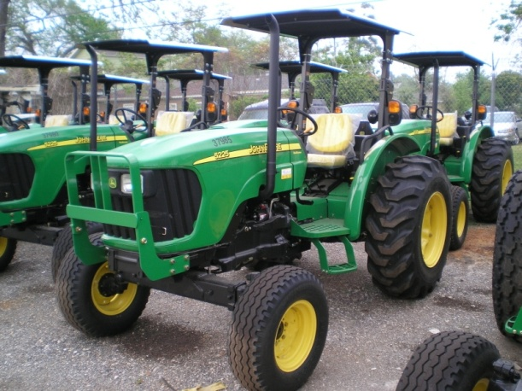
City of Houston Fleet Management Department
Scott Minnix, Director
September 19, 2011

Slide 2
FMD Agenda
Organization Update
Fuel Program Update
Fleet Size
Accomplishments
Revenue & Savings Update

Slide 3
FMD Organization Update
Final stages of consolidation roadmap
Partnering with HFD, HPD, Solid Waste, and Parks & Rec in managing their fleets
City has closed six fleet maintenance facilities to date. Continuing to analyze operational requirements to target further closures
NAPA roll-out complete across fifteen fleet maintenance sites in FMD (ten stores, five consignment locations)
Planning for financial and operational consolidation of PWE fleet maintenance
Analyzing fuel requirements across 69 citywide fuel sites to target further closures
Leveraging investment in fleet management system M5 for greater productivity and business analysis

Slide 4
FMD Fuel Program Update
Fuel Consumption Statistics:
Total bulk fuel purchased Jul 2009 - Jun 2010 – 9,985,202 g.
Total bulk fuel purchased Jul 2010 - Jun 2011 – 8,924,538 g.
Reduction of 1,060,664 gallons
Total cost of bulk fuel Jul 2009 - Jun 2010 – $23,011,873
Total cost of bulk fuel Jul 2010 - Jun 2011 – $25,282,853
Increased cost of fuel is $2,270,980

Slide 5
FMD Fuel Program Update
Fuel Usage Statistics:
90% of the fuel consumed by the fleet is dispensed at the City’s 69 fuel sites; 10% is dispensed at retail locations using fuel cards
66% of the fuel consumed is unleaded, 33% is diesel
Over past six months, average price of unleaded fuel paid by the City was $3.25, and diesel was $3.34
Citywide fleet consumes 765,000 gallons or $2,258,000 fuel on average per month from citywide fuel sites
Fuel card expenditures average $311,000 per month

Slide 6
FMD Fleet Size
City fleet reduced by 47 vehicles in first two months of FY12
Citywide fleet size is 12,700
Planned vehicle replacements for FY12 is 605 or 4.7% of fleet
Total amount budgeted for vehicle replacements is $26,789,000

Slide 7
FMD Fleet Size
FY12 Rolling Stock Vehicle Replacements - Where will the money go?
Top 10 Vehicle Classes by Qty |  | Top 10 Vehicle Classes by $
Sedan, Patrol Full Size | 122 | Sedan, Patrol Full Size | $3,528,442
Sedan, Compact Lease | 46 | Truck, Fire Pumper | $1,850,083
Mower, Rotary Ride | 38 | Truck, Refuse S/Load Auto | $1,734,775
Truck, P/U 2x4 1/2T | 26 | Truck, Fire Aerial Ladder | $1,670,617
Auxillary Equipment | 17 | Truck, Fire Crash/Rescue | $1,507,099
Sedan, Invgt Compact | 15 | Generator, Trailer Mount | $1,158,524
Sedan, Invgt Fullsize | 14 | Truck, Hole Patcher Md | $863,400
Sedan, Invgt Interm | 13 | Backhoe, Loader | $617,000
Trailer, Utility | 13 | Truck, Dump 10 Yd Md | $518,497
Truck, Utility 1T | 11 | Mower, Rotary Ride | $483,765

Slide 8
FMD Fleet Size
FY12 Rolling Stock Replacement Criteria:

Slide 9
FMD Accomplishments
Over past 60 days:
Transitioned and aligned employees on new fleet functions and strategic goals
Developed and implemented FY12 chargeback model for maintenance and fuel
Consistently met vehicle availability requirements for all departments
Implemented work order billing process flow across department
Created parts-on-order tracking processes for maintenance shops and NAPA
Standardized daily equipment readiness report across all maintenance shops
Launched fuel site quadrant inspection and maintenance program
Evaluated and awarded bids for fuel, fuel transport, and fuel tank testing contracts
Installed motor pool at Houston Permitting Center in effort to eliminate forty vehicles

Slide 10
FMD Revenue & Savings Update
Vehicle Fleet Consolidation Plan Update
 |  | FY11 |  | FY12
 | Revenue | Cost Savings | Revenue | Cost Savings* | Notes
Fuel Program | $0 | $78,918 | $0 | $189,404 | 29 fuel sites closed
Parts Project | $1,492,433 | $0 | $0 | $0 | Actual revenue from Parks, Fire, Police and SWD FY11 buy-back
Take-Home Vehicles | $1,126,718 | $410,228 | $370,813 | $0 | Actual revenue from 757 THV for five FY12 pay periods
Personnel Consolidation | $0 | $1,691,885 | $0 | $0 | 34 layoffs
Vehicle Reductions | $475,213 | $206,793 | $98,162 | $491,841 | 254 sold / 159 at auction
 | $3,094,364 | $2,387,824 | $468,975 | $681,245
FY11 COH Revenue/Cost Savings $5,482,188 |  |  | FY12 COH Revenue/Cost Savings $1,150,220
FY11 Consultant’s Projected Cost Savings $9,963,000 |  |  | FY12 Consultant’s Projected Cost Savings $11,866,000
Savings TBD
* Carries FY11 monthly cost savings across twelve mo of FY12

