Slide 1

BFA Budget Amendment
January 27, 2021

Slide 2
BFA Amendment
Travis | 12.02 | In Fiscal Year 2021, the City of Houston will begin to charge divisions of departments rent on a square footage basis for all space. If a division rents space, the division’s charge should include all costs necessary to maintain the property (that the City provides and/or pays). With respect to properties owned by the City, the General Services Department should include property maintenance costs and depreciation in the division’s square footage rent calculation.
 | NOTE: This will transform division’s outlook from viewing space as a centrally absorbed expenses, to a cost. divisions will ultimately downsize their space if they have unused space and do not want to absorb additional overhead expenses.

Slide 3
GSD Responsibilities
The General Services Department was created under City Ordinance No. 99-378, § 5, 4-21-99.
Section 2-434. – Functions. The [General Services] Department shall:
Be responsible for construction and remodeling of city buildings, including management and provision of in-house and contract services for design of projects, construction bidding, construction contract management, construction-related testing services and construction-related environmental services;
Perform facilities management services including review of requirements for space in city buildings, negotiations of city building space leases, whether the city is the lessor or the lessee, assignment of space in city buildings, development of office size and furnishing standards, management of furnishings installations and office moves and related services whether performed directly by the department or by contractors; (AP Policy 7-4)
Acquire real property and dispose of surplus real property in coordination with Houston Public Works;
Manage and oversee energy programs for city buildings;
Provide on-site building maintenance and operations services for buildings assigned to the department for that purpose, including janitorial, cleaning, building systems maintenance, minor repairs, carpentry and construction work and security operation and maintenance;
Render assistance to other city departments upon request for buildings that may not be under the direct management of the department on issues relating to building management; and
For any matters involving procurement, as defined in section 15-42 of this Code, defer to the chief procurement officer as required in section 15-43 of this Code.
The foregoing duties and functions shall not extend to aviation department properties, unless so requested by the aviation department.

Slide 4

City of Houston Insured Properties

Slide 5
City Wide Insured Properties
The City of Houston has 2,844 facilities, which covers roughly 31,626,635 Sq. Ft.
 | Number of Facilities | Sq. Ft. | Building Value
Owned | 2,828 | 31,407,531 | $ 10,557,814,296
Vacant | 14 | 192,075 | $ 31,277,342
Total | 2,842 | 31,599,606 | $ 10,589,091,638
Source: Property Schedule Spreadsheet Provided by ARA | July 2020
Notes:
Source: Property Schedule Spreadsheet Provided by ARA | July 2020

Slide 6
General Services Department Properties

Slide 7
GSD Maintained Properties
 | # of Locations | St. Ft.
ARA, General Govt., Municipal Courts and HPW | 21 | 2,156,181
Library | 41 | 909,722
Fire | 117 | 1,088,846
Health | 42 | 1,101,402
Police | 71 | 2,567,011
Fleet | 24 | 364,664
Total | 316 | 8,187,826
The General Services Department currently maintains 316 locations, which covers roughly 8,187,826 sq. ft.
Notes:
Source: Property Listing Spreadsheet Provided by GSD: Property Management | June 2020

Slide 8
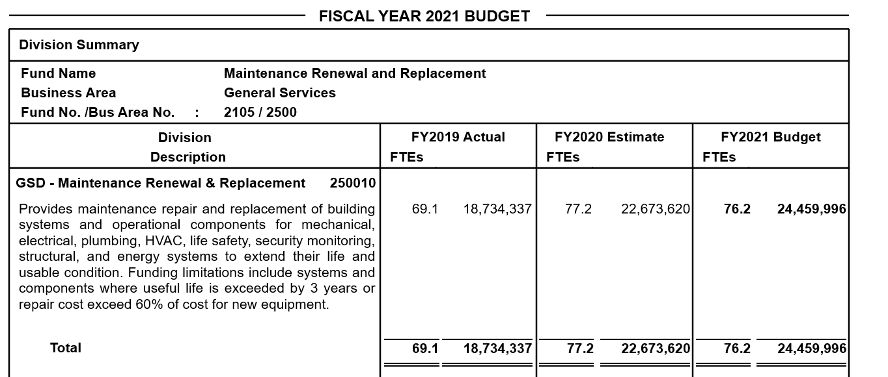
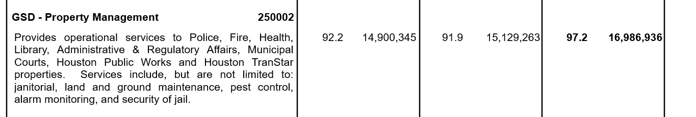
GSD Operational Cost
Fund 2105
Fund 1000
Notes:
Total Cost $ 41,446,932

Slide 9
City Leases
City as Landlord
(Revenue)
City as Tenant
(Expenses)
Dept | Rent/Yr. | # of Locations
ARA | $ 239,631.00 | 1
HCD | $ 1,522,809.00 | 1
HFD | $ 1,584,756.90 | 1
HHS | $ 825,503.52 | 7
HITS | $ 320,407.00 | 1
HPD | $ 549,401.52 | 4
HPL | $ 145,726.00 | 1
PWE | $ 535,971.00 | 5
SWM | $ 5,985.00 | 1
Grand Total | $ 5,730,190.94 | 22
Dept | Rent/Yr. | # of Locations
HHS | $ 670,631.00 | 30
HPD | $ 97,276.00 | 2
HPW | $ 205,623.40 | 15
SWM | $ 21,663.00 | 1
Grand Total | $ 995,193.40 | 48

Slide 10
Examples - City as Tenants
Department | Use | Why does City Lease Space | Location | Square Feet/Rate | Parking Spaces/Rate | Cost Per Year
HFD | Administration/ EMS | City does not have contiguous space available. HFD desires CBD and proximity to City’s 500 Brazos parking lot. | 500 Jefferson | 55,109 (previously 63,850) $10+$10OE=$20 | 66 $65/space/month | $1,106,470.00
DON-HPD | Administration/ Inspectors/ Hearing Officials | City does not have contiguous space available. DON has heavy equipment and large number of fleet vehicles to park. DON holds public meetings. | 601 Sawyer | 31,853 (previously 44,779) $13.35+$9.65OE=$23 | 124 Charge is in the rent. | $732,619.00
HPD | Psychological Services | Confidentiality | 12941 North Freeway | 5,293 $19.75 gross | As needed. Charge is in the rent. | $104,536.75
HPD | Internal Affairs | Confidentiality | 1415 N Loop West | 2,602 $20.25 gross | As needed. Charge is in the rent. | $52,690.50
HPW | Inspectors | Distributed services | 1701 Seamist | 5,115 $16.32 gross | As needed. Charge is in the rent. | $83,476.80
HPW | Inspectors | Distributed services | 4300 Wayside | 3,960 $10.08 gross | As needed. Charge is in the rent. | $39,916.80
 |  |  |  |  |  | $ 2,119,709.85

Slide 11
Examples of City Owned Office Facilities
Department | Use | Location | Square Feet
Mayor’s Office, HTV, Controllers, DON | Administration | City Hall 901 Bagby | 150,717 11 floors
City Council, City Secretary, GSD, Legal, DON, Homeland Security, Fleet | Administration | City Hall Annex 900 Bagby | 366,204 5 floors; full basement;

Slide 12
Workplace Analysis and Improvement Strategies
2015 PDR Study

Slide 13
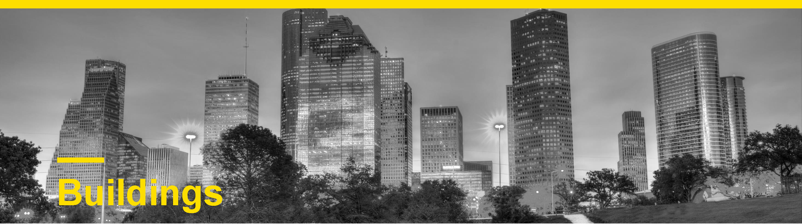
Applied Flexible Solution to all five buildings in scope
611 Walker
City Hall Annex
City Hall
1205 Dart (HFD Fleet Complex)
6903 Perimeter Park (HFD Brac)

Slide 14
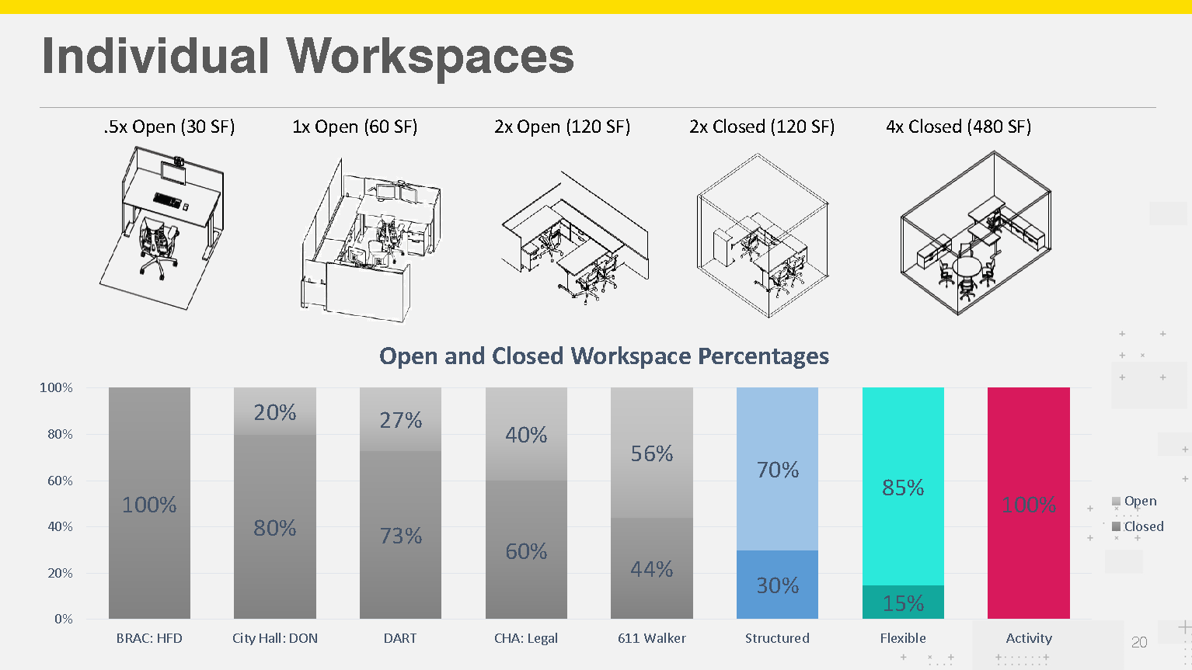

Slide 15
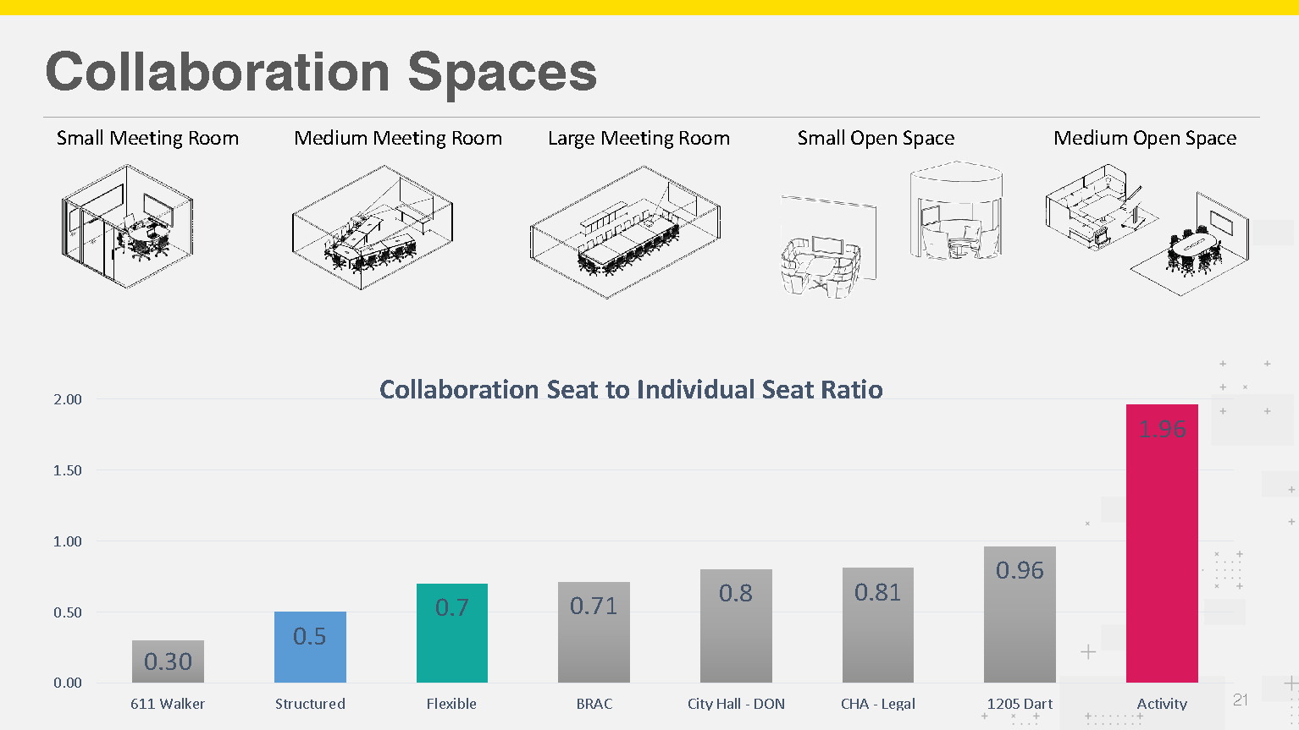

Slide 16
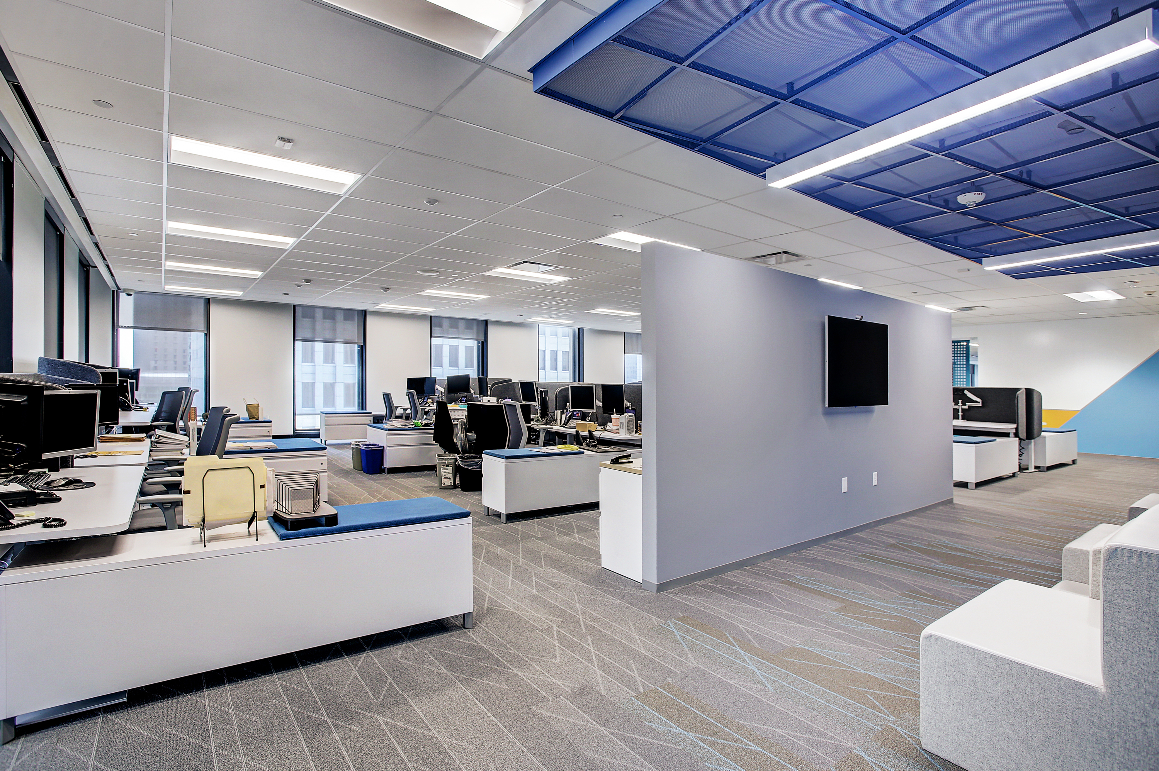
611 Walker - 8th Floor
Project Cost: $2.5MM | Gained 29 Seats

Slide 17
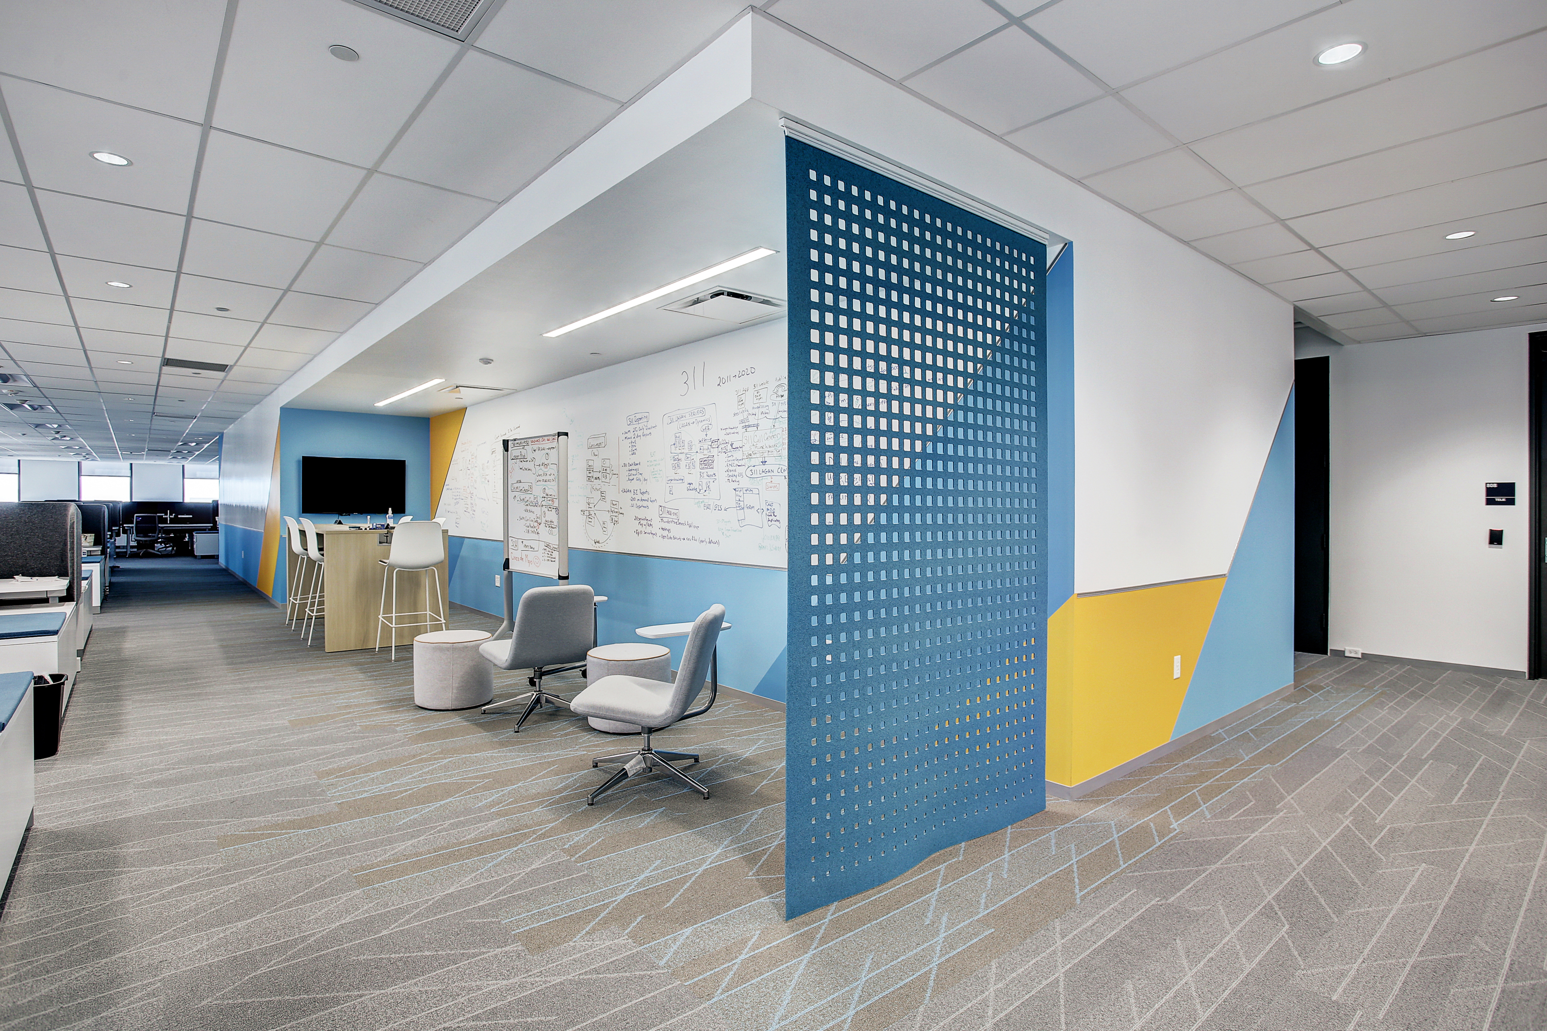
611 Walker - 9th Floor
Project Cost: $2.5MM | Gained 15 Seats
Notes:
Total Project Cost (2 floors) – 5MM | Total seats gained 44.

Slide 18
City of Houston Workplace Guidelines and Standards

Slide 19




City of Houston Workplace Guidelines and Standards
Interior Architects produced workplace guidelines and standards for the City of Houston in July 2020.
GSD will incorporate these guidelines for new leases and new construction buildouts.
Space Types
Ratio Metrics
Planning
Space Standards and Furniture

Slide 20
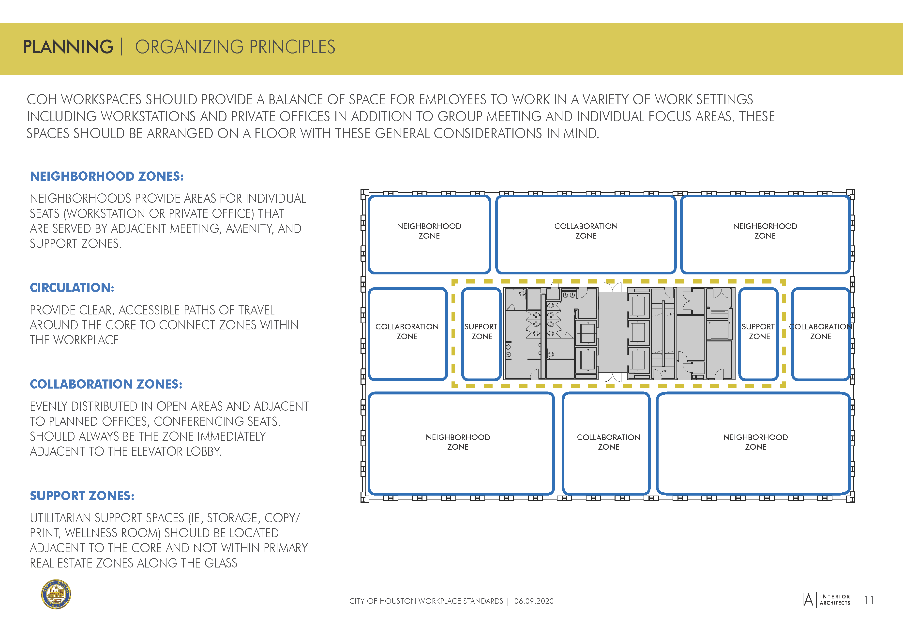

Slide 21
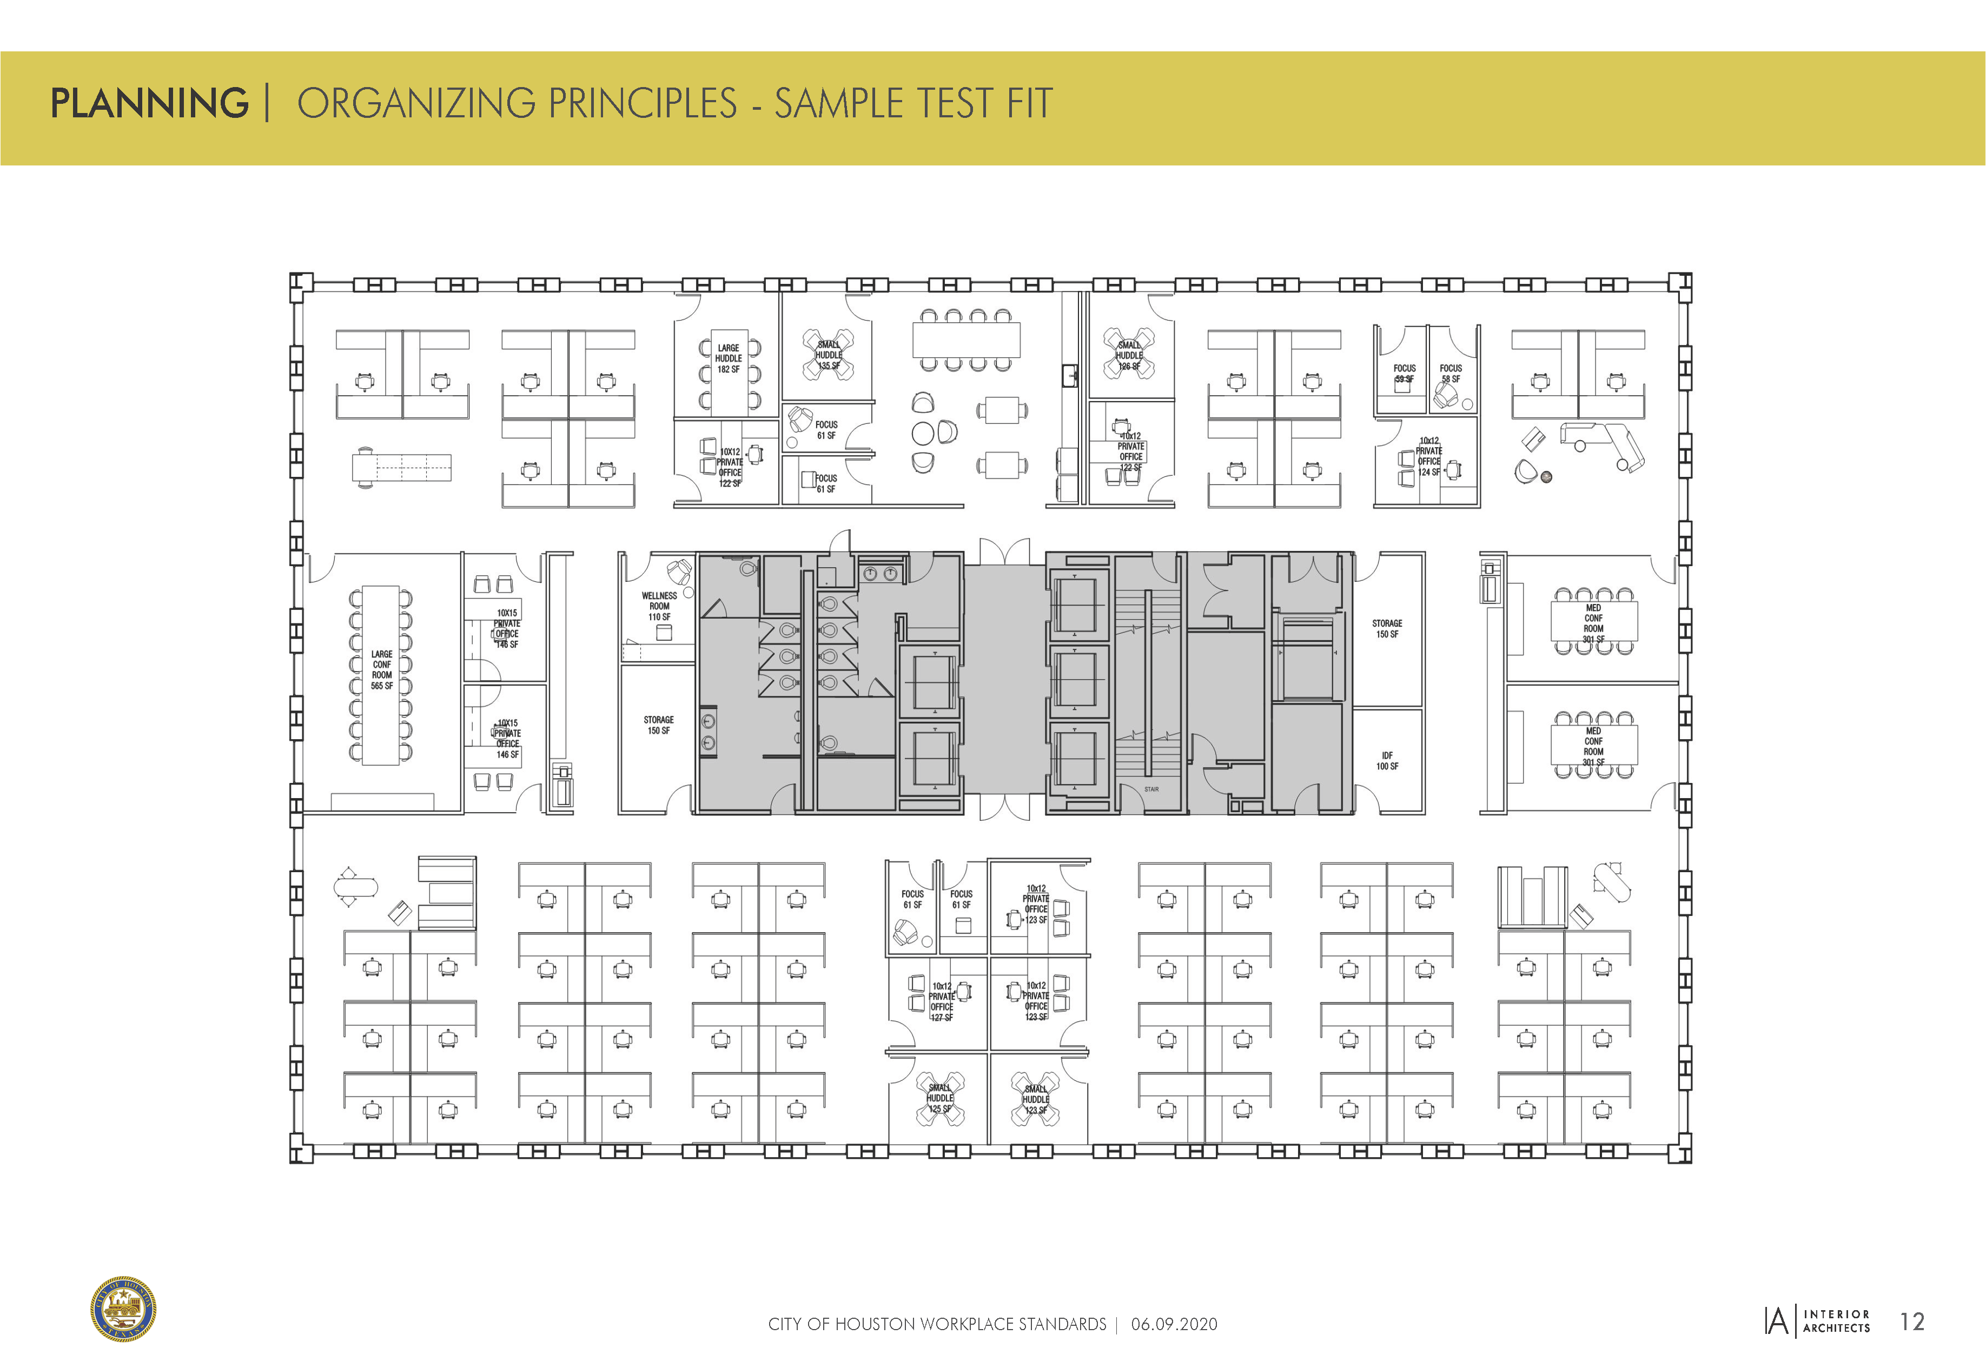

Slide 22
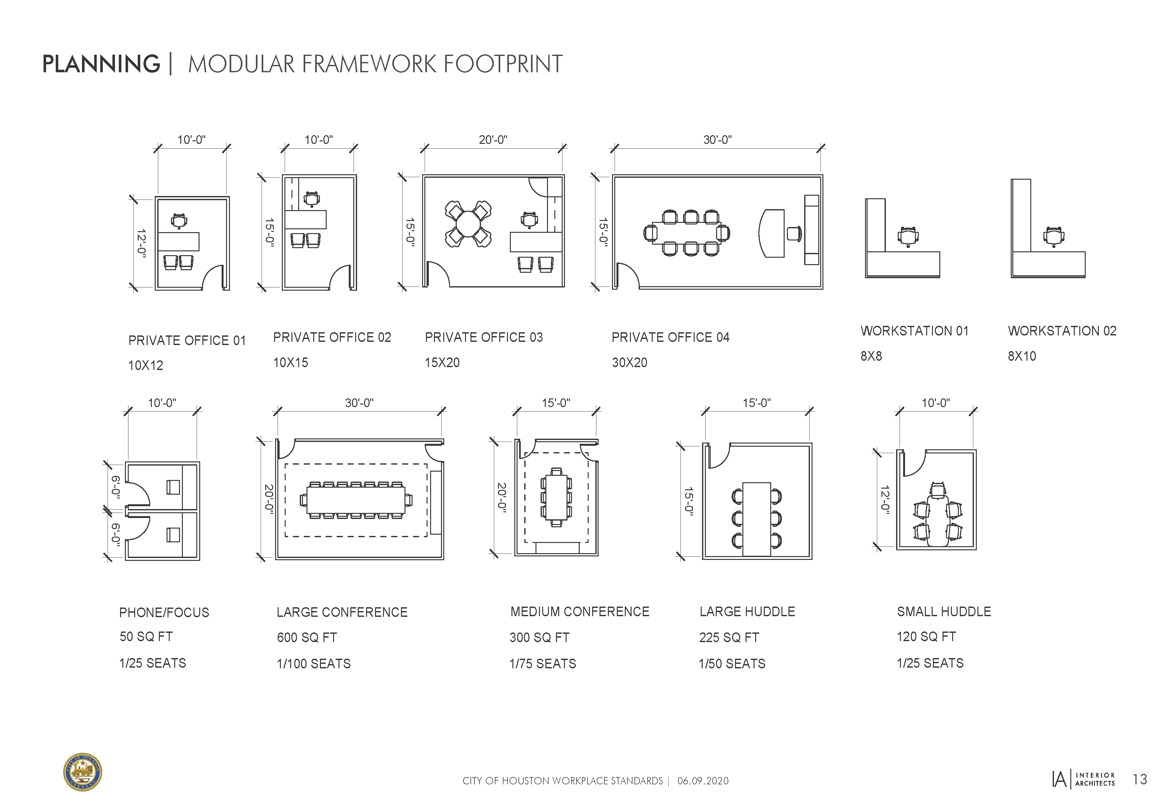
GSD: Where Are We Now?
Administrative Policy 7-4
Space Utilization and Furniture Standards
The updated Administrative Policy was developed to start maximizing office space. This will be achieved by suggesting 85% open office space and 15% closed office to clients for future buildouts.
Notes:
Discuss section

