Slide 1
Houston’s seven State-Designated cultural districts

Slide 2

Bao-Long Chu Houston endowment Program Director, Arts and Parks

Slide 3
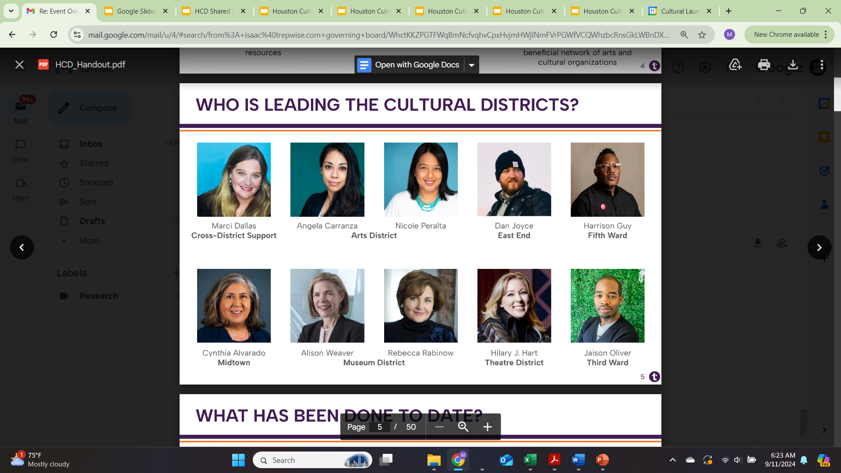
Houston Cultural District Leadership

Slide 4
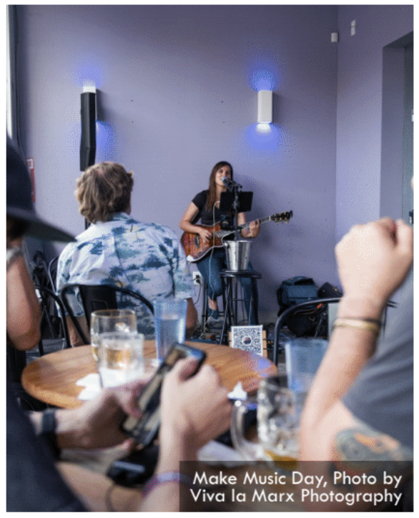

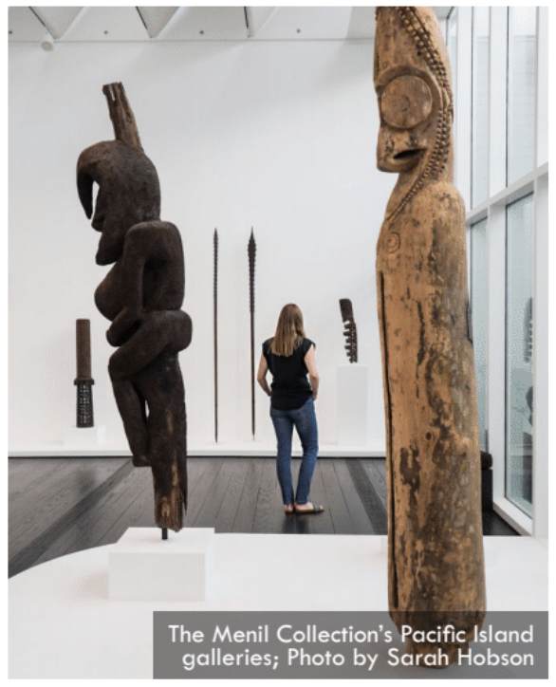
CREATOR-FOCUSED DISTRICTS
Arts District, Midtown
Offer robust engagement opportunities for independent artists in the greater Houston area and a high concentration of for-profit arts businesses such as galleries and artist studios. Programs produced by these Cultural Districts include art markets, artist residencies, artist microgrants, and consolidated postings for artist opportunities and resources
HERITAGE-FOCUSED DISTRICTS
5th Ward, East End, Third Ward
Effectively prioritize the celebration of neighborhood creativity and preservation of cultural legacy. They contain a high concentration of heritage sites, and programming produced by the Districts includes experiences rooted in cultural heritage and legacy, artist councils, and town halls for the neighborhood's creative community
INSTITUTION-FOCUSED DISTRICTS
Museum District, Theater District
Are the most centralized of the Cultural Districts and contain a high concentration of mid-sized to large arts and cultural non-profits. Governed by a membership structure, these Districts are led by representatives of member organizations and facilitate a beneficial network of arts and cultural organizations

Slide 5
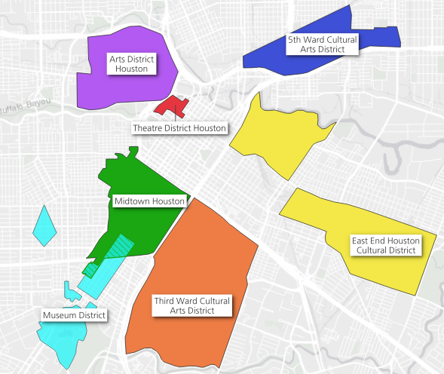
Together, Houston’s Cultural Districts represent a cross-section of the diverse neighborhoods and arts experiences that make Houston so unique. While each has a distinct identity, function and goal, all of these districts use art as a tool to educate, entertain and improve quality of life while supporting our community and city economy.
Collectively the cultural districts share concerns about preserving, strengthening and sustaining their districts so that they, in turn, will attract investment economic growth and creative/cultural engagement not only to the cultural districts but also more broadly for the arts across Houston.

Slide 6
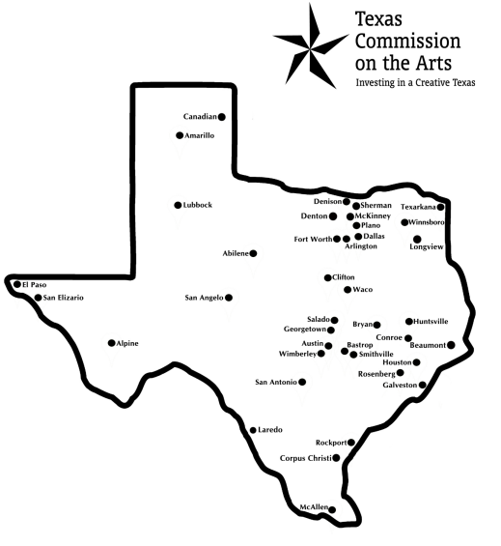
Texas Cultural District Program
In 2005, the Texas Legislature granted Texas Commission on the Arts authority to designate cultural districts in cities across Texas.
Cultural districts are defined as special zones that harness the power of cultural resources to stimulate economic development and community vitality.
Currently, there are 52 TCA-designated Cultural Districts in 39 cities.
Seven of these districts are located in Houston. The most of any city in Texas.

Slide 7
Texas cultural district program Grants
Eight years of state grant making to Cultural Districts Program
More than $30 million in grants across Texas
More than $15 million to Houston
This month
$4 million in state arts grant funding was approved for Houston
$2.7 million of that was through the cultural districts program

Slide 8

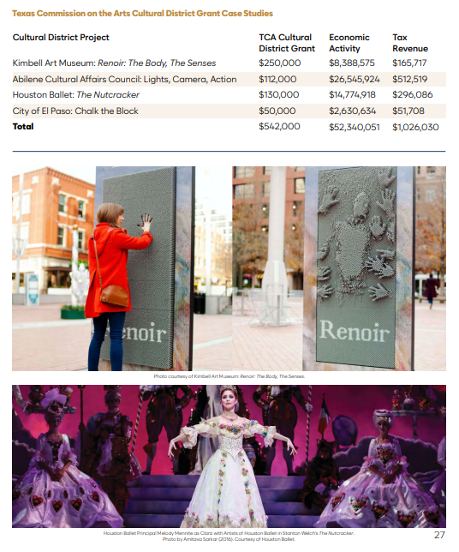
Impact of
Texas Commission on the Arts
Cultural District Grants Program
in Houston

Slide 9
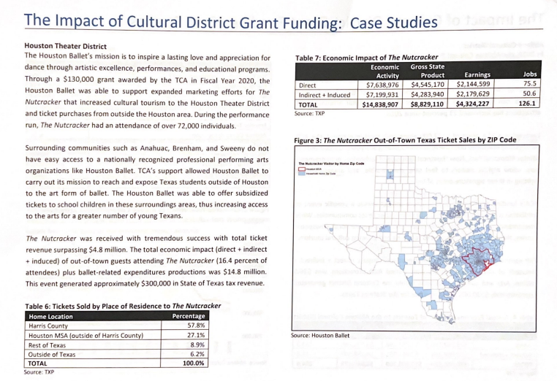
Impact of
Texas Commission on the Arts
Cultural District Grants Program
in Houston

Slide 10
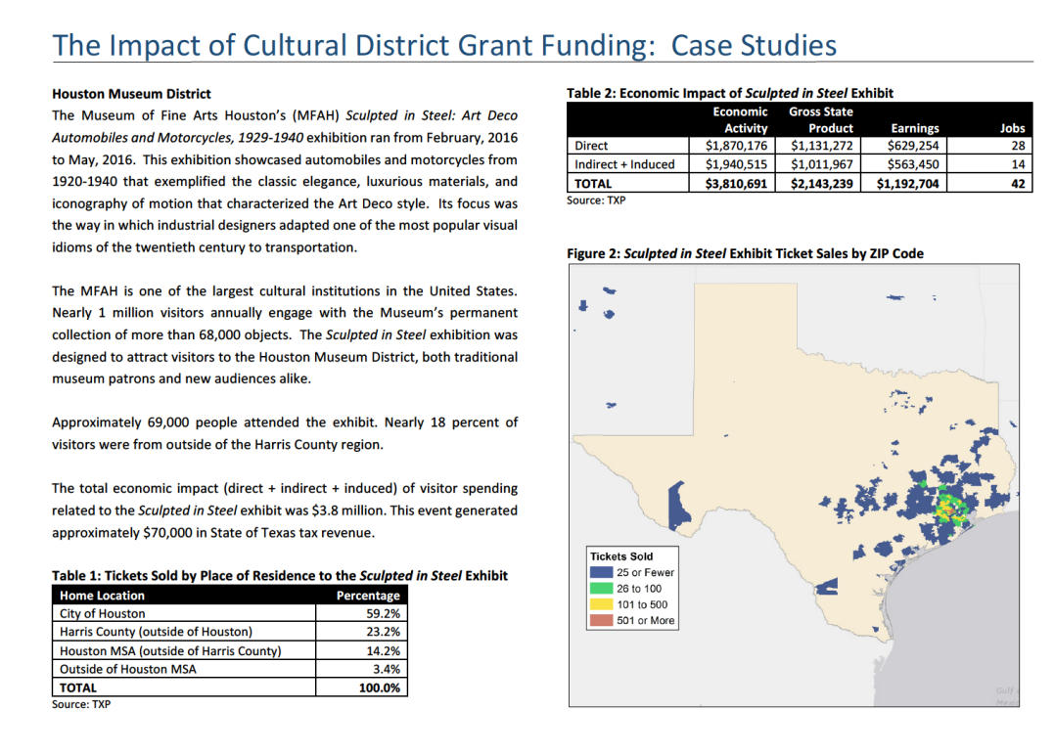
Impact of
Texas Commission on the Arts
Cultural District Grants Program
in Houston

Slide 11
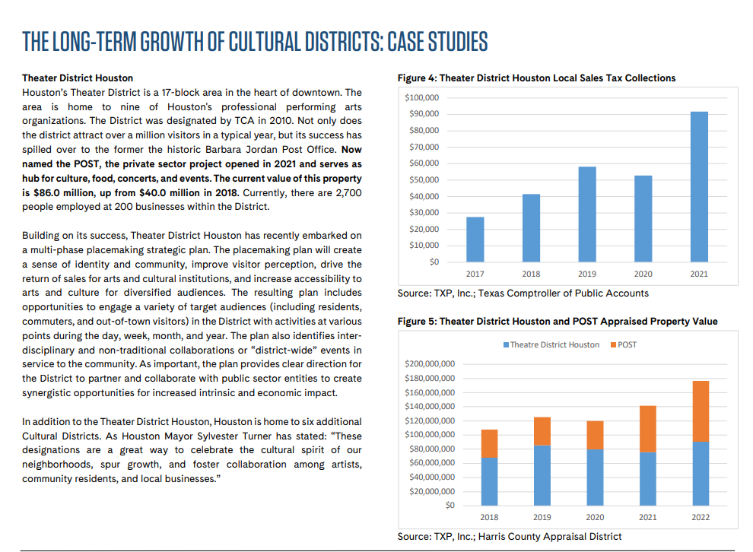
Impact of
Texas Commission on the Arts
Cultural District Grants Program
in Houston

Slide 12
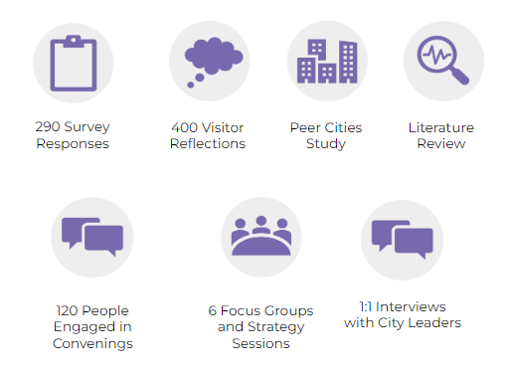
Houston Cultural Districts Collective Work

Slide 13
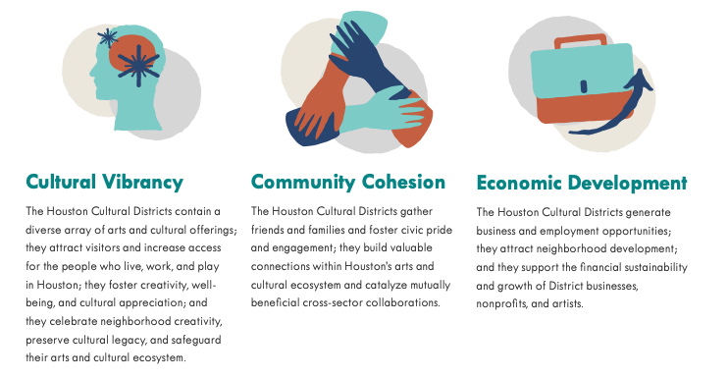
Houston Cultural Districts Collective Work

Slide 14
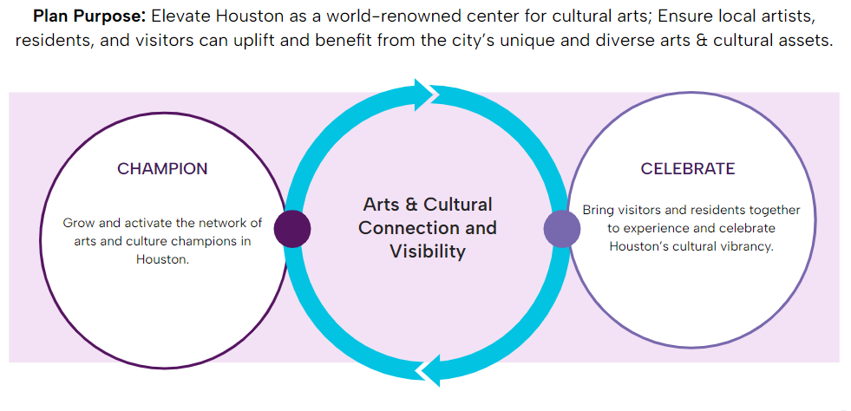
Houston Cultural Districts Collective Work

